Slide 1
Business Innovation and Professional Associations
“Challenges and Opportunities”
The Enforme Collaborative
1.16.2020

Slide 2
Proud to Serve Some of the World’s Leading
Professional Associations

Slide 3
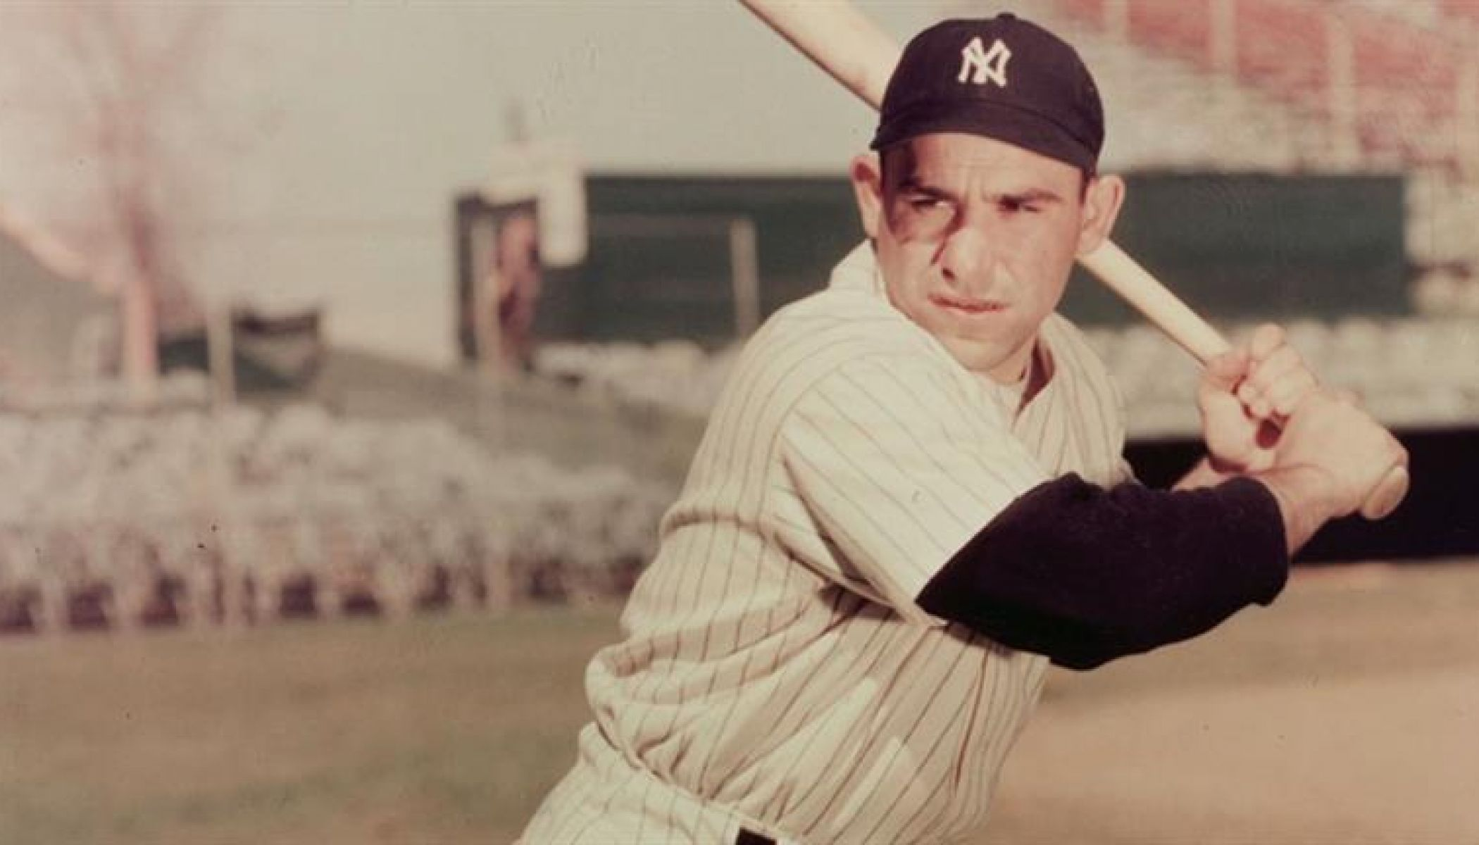
“It’s tough to make predictions, especially about the future.”
- Yogi Berra

Slide 4
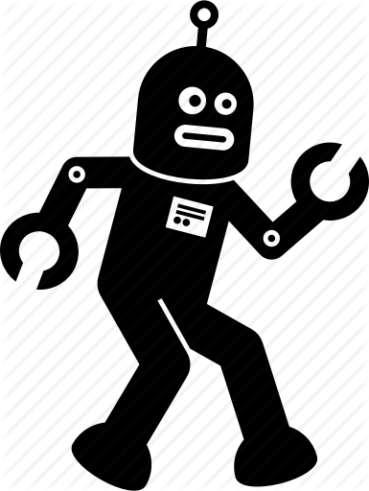
The Industrial Revolutions
^{1st: Steam Power}
2nd: Electricity and the Assembly line
3rd: Computers and Advanced Telecommunications
4th: The Digital and Advanced Analytic Age
The Enforme Collaborative 1.16.2020

Slide 5
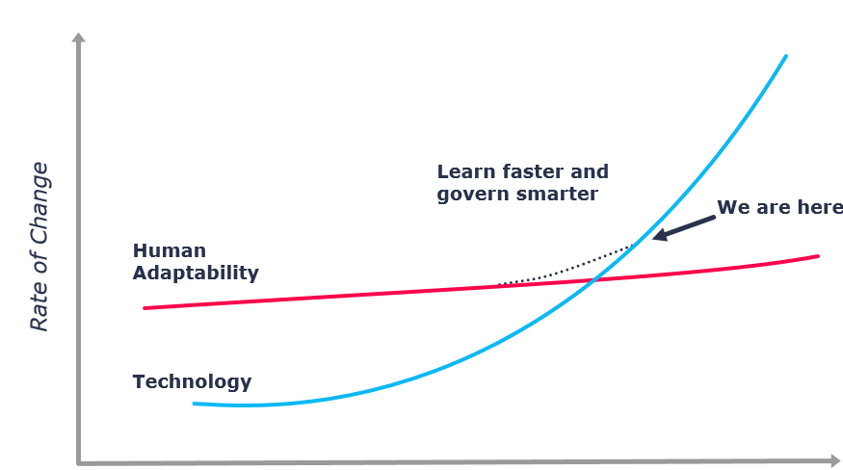
Our Industrial Revolution
The 4th Industrial Revolution: The Digital and Advanced Analytic Age
“We stand on the brink of a technological
revolution that will fundamentally alter the way we live, work, and relate to one another. In its scale, scope, and complexity, the transformation will be unlike anything humankind has experienced before.”
- Klaus Schwabe, the President of the World Economic Forum.
The Enforme Collaborative 1.16.2020

Slide 6
Medical Societies at a Time Uncertainty
Traditional economic pillars are flat to declining
Early career professionals have a different view of association membership
The ever-accelerating pace of professional life interferes with association membership
Reduced institutional support for association related activities
Competition for attention from an ever-expanding universe of information providers
It’s difficult for associations to keep pace with rapidly changing tech and patterns of content consumption
The Enforme Collaborative 1.16.2020

Slide 7
Medical Societies at a Time Uncertainty
There’s a relevance gap
Traditional economic pillars are flat to declining
Early career professionals have a different view of association membership
The ever-accelerating pace of professional life interferes with association membership
Reduced institutional support for association related activities
Competition for attention from an ever-expanding universe of information providers
It’s difficult for associations to keep pace with rapidly changing tech and patterns of content consumption
The Enforme Collaborative 1.16.2020

Slide 8
Medical Societies at a Time Uncertainty
There’s a relevance gap
“Failing to evolve at the same rate as our customers’ expectations….”
Traditional economic pillars are flat to declining
Early career professionals have a different view of association membership
The ever-accelerating pace of professional life interferes with association membership
Reduced institutional support for association related activities
Competition for attention from an ever-expanding universe of information providers
It’s difficult for associations to keep pace with rapidly changing tech and patterns of content consumption
The Enforme Collaborative 1.16.2020

Slide 9
Three Essential Actions
Recognize the need for change
Creating an environment that fosters change
Creating the organizational structures that support innovation
The Enforme Collaborative 1.16.2020

Slide 10
The Future of Medical Societies
The future is data immersive
The future is defined by AI
The future is International
The future is revealed at the frontiers
The future is indifferent to you current organizational structure
The future is voice interactive
The future is radically inclusive
The future is real-time
The future is mobile
The future is experimental and experiential
The Enforme Collaborative 1.16.2020

Slide 11
The Future is Data Immersive
Healthcare data is growing faster than manufacturing, financial services or media
Successful associations will be defined by their data analytic competencies, not by their data holdings
It’s not about the data, it’s about what you do with it
The future will reveal itself at the boundaries of traditional datasets & organizational constructs
The Enforme Collaborative 1.16.2020

Slide 12
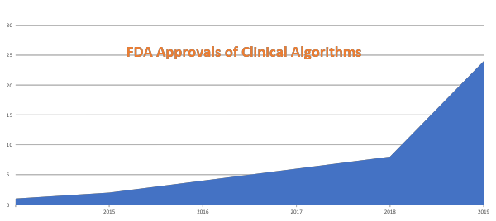
The Future is AI Driven
The Enforme Collaborative 1.16.2020

Slide 13
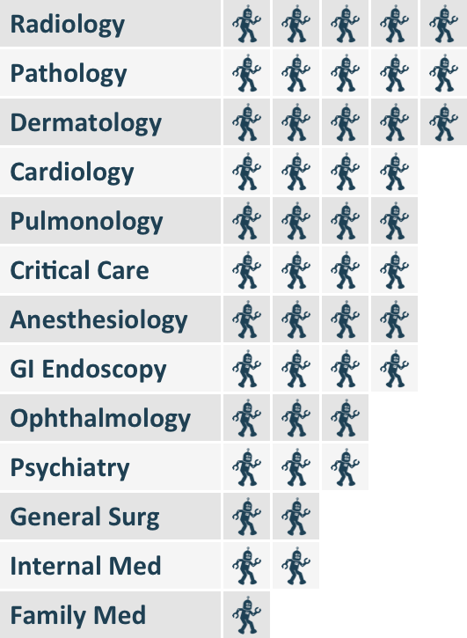
The Impact of AI on the Medical Specialties
Robot Scoring:
5 - Profound Reconsideration
4 - Essential Daily Tool
3 - Guidelines Mandated
2 - Diagnostic Aid
1 - Little Change in Practice
The Enforme Collaborative 1.16.2020

Slide 14
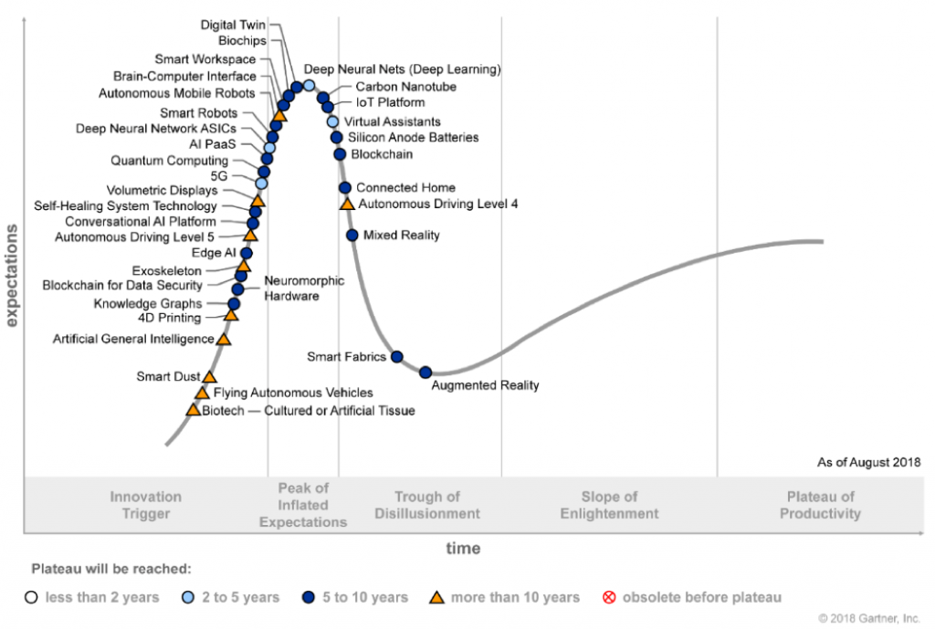
AI’s Journey Through the Technology Adoption Cycle
AI’s Impact on “pattern recognition in medicine”
The Enforme Collaborative 1.16.2020

Slide 15
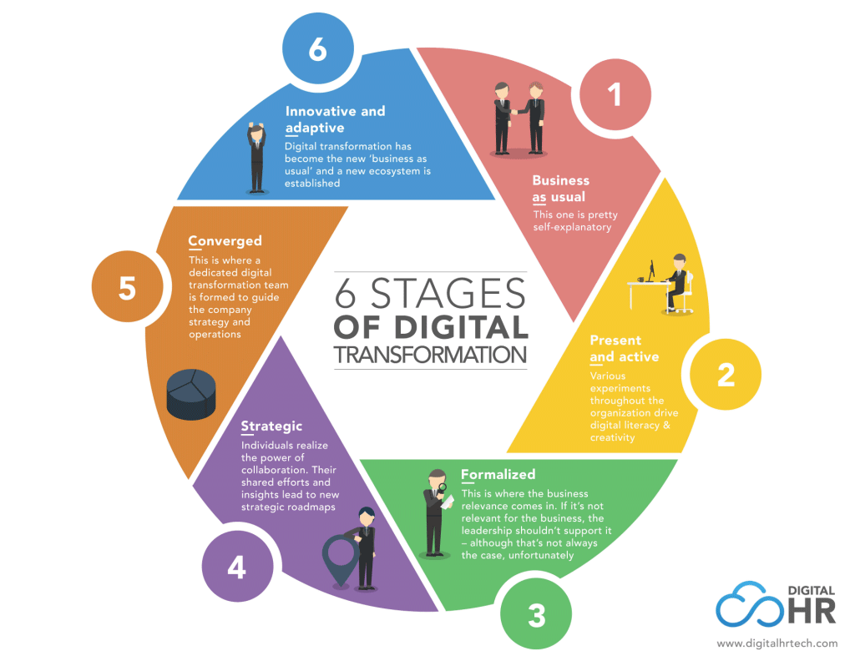
The Future is Data Immersive
Digital Transformation: Convergence of digital technologies with an organizational structure that enables a rapid and flexible response to an ever-changing external environment.
Digital Transformation is less about technology and more about strategy, leadership, talent and data driven decision making.
Digital Transformation focuses on achieving a detailed understanding of today’s member and the identification of potential new membership groups and business allies.
Digital Transformation: Allows organizations to evolve at the pace of your members expectations
The Enforme Collaborative 1.16.2020

Slide 16
Nurturing a Culture of Innovation
Launch an “Innovation Challenge”
Appoint a cross divisional “Innovation Team”
Partner with local tech incubators
Build new revenue growth into the budget
Include innovation in annual goals
Give staff dedicated time to explore new opportunities
Include members in the innovation agenda
Search out new alliances such as consumer tech, real world evidence
The Enforme Collaborative 1.16.2020

Slide 17
Closing Thoughts
In the future, there will be only be two kinds of people: those who tell computers what to do and those who are told by computers what to do. Marc Andreessen
So too will it be in medicine. There will be medical societies that boldly lead this fourth revolution and others that will be left to follow.
The Enforme Collaborative 1.16.2020

Slide 18
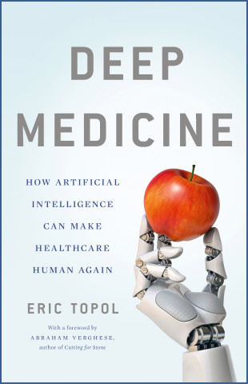
Food For Thought
A Time of Uncertainty for Medical Societies
http://bit.ly/2RkfgZs
Business Innovation & Professional Associations http://bit.ly/2NmGXj2
Artificial Intelligence and Its Impact on Professional Associations
http://bit.ly/38eg2ht
The Culture That Powers High Performing Professional Associations
http://bit.ly/3897WXn
Hamburger Economics and Professional Associations
http://bit.ly/2texJhS
The Enforme Collaborative 1.16.2020

Slide 19
Thank You

