Slide 1
Modernizing Compensation and Benefits
Discussions
Fourth Quarter - 2019

Slide 2
Why is the Selection, Recruitment, and Retention of Top Talent so Critical?
How do you define top talent?
What objective does top talent optimize?
What does deficient talent impact?

Slide 3
Why is the Selection, Recruitment, and Retention of Top Talent so Critical?
Why do we lose our talent?
What is the impact of lost talent?
Why do we keep talking about it?

Slide 4
Why is the Selection, Recruitment, and Retention of Top Talent so Critical?
Consider the real "total cost" of losing an employee
Many studies show that the total cost of losing an employee can range from tens of thousands of dollars to as high as one and a half times annual salary.
Cost of hiring a new person (advertising, interviewing, screening, hiring)
Cost of onboarding a new person (training, management time)
Lost productivity (a new person may take one to two years to reach the productivity of an existing person)
Lost engagement (other employees who see high turnover may disengage and lose productivity)
Customer service and errors (new employees take longer and are often less adept at solving problems). In healthcare this may result in much higher error rates, illness, and other very expensive costs (which are not seen by HR)
Training cost (over 2-3 years you likely invest 10-20% of an employee's salary or more in training, that is gone)
Cultural impact (whenever someone leaves others take time to ask "why?").

Slide 5
Value Planning Concepts from the For Profit World
Exit Plan
External Sale
Internal Sale
Recapitalization
Continuity Plan
Mission Continuity
Project Continuity
Value Measure
Tangibles
Intangibles

Slide 6
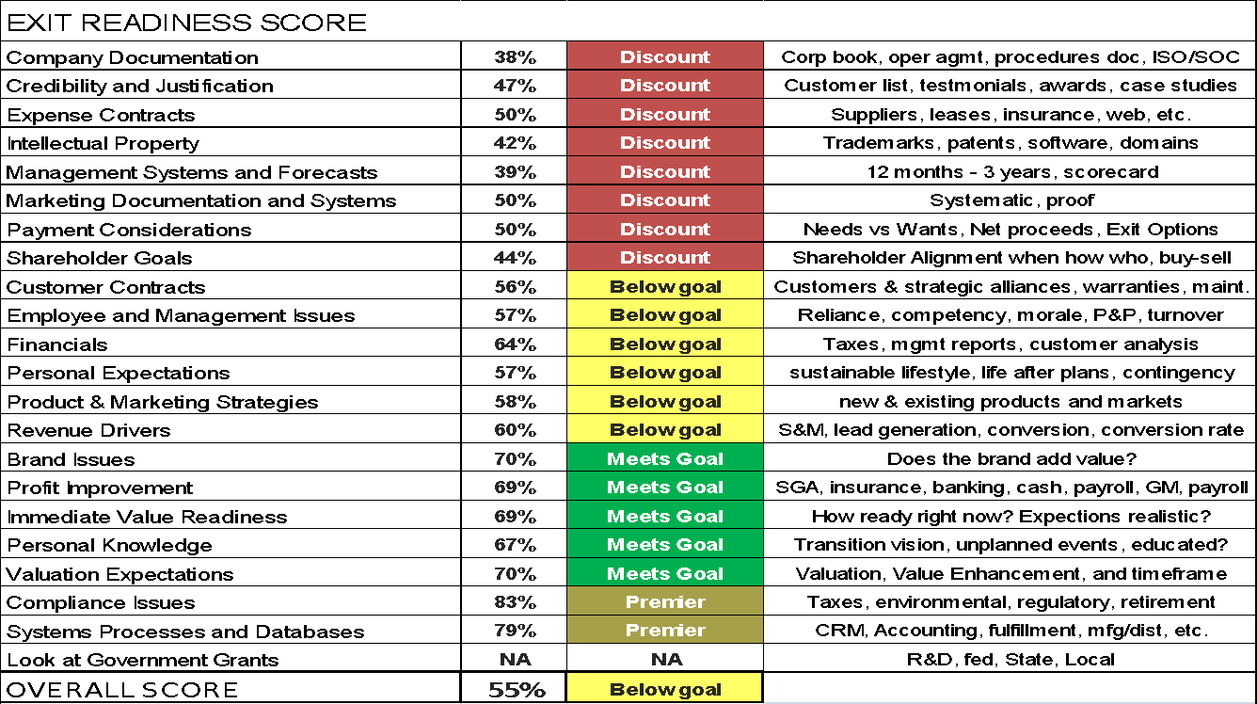
Example Organizational Value Index
Intangibles driving value

Slide 7
Organizational Value Index Applied
10M Company
Value based on tangibles is 3 - 7 X EBITDA
1
55% of 7 = 3.85
2
10M X 3.85 = $38,500,000.00
3
10M X 7 = $70,000,000.00
4
Difference = $31,500,000.00
5

Slide 8
How To Self-Assess
Some Basics That Can Be Optimized but often stagnate
Review compensation and benefits packages at least annually. Pay attention to trends in the marketplace and have HR update you.
Pay attention to employees’ personal needs and offer more flexibility where you can.
How long ago was the last meaningful improvement? Often seems like yesterday.
Bolster employees’ engagement.
Managers often overlook how important a positive work environment is for staffers, and how far meaningful recognition and praise from managers can go to achieve that. Awards, recognition and praise might just be the single most cost-effective way to maintain a happy, productive work force.
“Most cited reason for employee resignation was their immediate supervisor”
“No employee every quit over too much praise”

Slide 9
Engagement - 12 Steps
1.
Feeling connected to the purpose and vision
Engaged owners and leaders
Clarity on their role
Clearly defined end results
Open Feedback
Communication
Support and resources to help staff perform in their role
A sense of community and teamwork
Learning and developing opportunities
Fair rewards for their efforts
Freedom to operate within boundaries, use their judgment and share ideas
Feeling valued and appreciated
2.
3.
4.
5.
6.
7.
8.
9.
10.
11.
12.

Slide 10
Groundswell
Consider a “Plus One” Approach
Consider a Pathway for Growth
Consider Committees to Automate the Improvements
Consider a Champions Program

Slide 11
How To Self-Assess
Consider Abraham Maslow Analysis (Maslow’s Hierarchy of Needs)
Employee Engagement Surveys
EX = MX (Employee Experience = Customer/Member Experience
Alignment Strategies
Quantify success by your ACTIONS to improve the environment for your employees
Notes:
Lighting in factory

Slide 12
Maslow Applied to Employee Engagement
Abraham Maslow’s Hierarchy of needs
Self Actualization
Highly engaged (usually less than 15% of employees)
Importance
Engaged
Belonging
Almost engaged
Security
Not engaged
Survival
Disengaged

Slide 13
How to Prioritize Your Total Compensation Capital Investment – N.I.C.E.
Nudge
Incent
Nudge – Maintain Stewardship
Incent – Pursue Targets
Compete – Remain Relevant
Empower – Encourage Independence
Total Compensation
Compete
Empower
Notes:
Nudge Examples: Healthcare, Retirement Plan, Disability Insurance, Life Insurance
Incent Examples: Short and Long Term Compensation Rewards Like Deferred Compensation, Phantom Stock, etc.
Compete: Perquisites, Base Salary, Work/Life Benefits, Financial Planning
Empower: Provide Funding and Provide Options such as Pet Insurance, Concierge, Uber, Student Loan, Financial Wellness,

Slide 14
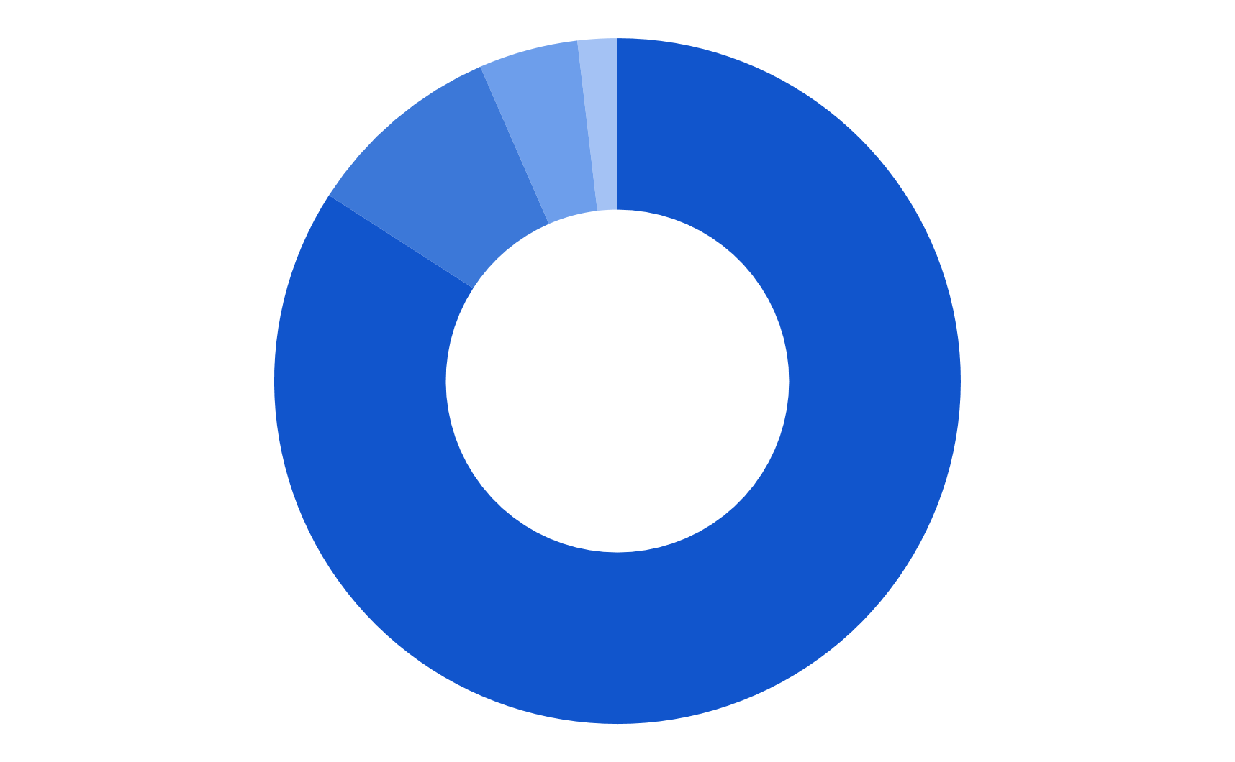
How To Self-Assess
Estimated Annual Spend Breakout*
Compensation
Health Care
Retirement Plan
Work/Life Balance
QUESTION
What would your compensation and benefits budget look like in 5 years if you transferred dollars from the largest quadrants with highest inflation to the smallest quadrant with the lowest inflation???
*Statistical Data Provided by The U.S. Census Bureau, The U.S. Bureau of Labor and Statistics, and The National Business Group on Health
Notes:
Selective Benefits

Slide 15
What Tools and Strategies Exist?
Considerations:
Cost
Specific Impact
Short Term Incentives
Taxation
Aggregate Impact
Long Term Incentives

Slide 16
What Tools and Strategies Exist?
Solutions:
Performance-Based Compensation
Short and Long Term Incentive Plans
Deferred Compensation
Split Dollar Options
Fringe Benefits
Executive and Retiree Medical Benefits
Virtual Personal Assistant
Personal Driver Outsourcing
Student Loan and College Savings
Selective Benefits and Perquisites
Supplemental Life Insurance
Advanced Disability Benefits
Long Term Care Planning and Insurance

Slide 17
Questions?

